Slide 1
1-Bit Adders

Slide 2
Multi-Bit Adders (CPAs)
Types of carry propagate adders (CPAs):
Ripple-carry (slow)
Carry-lookahead (CLA) (fast)
Prefix (faster)
Carry-lookahead and prefix adders faster for large adders but require more hardware
Skipping prefix for the sake of time, but:
It is similar to carry-lookahead with a prefix tree structure instead of what we’ll see for the CLA

Slide 3
Ripple-Carry Adder
Chain 1-bit adders together
Carry ripples through entire chain
Disadvantage: slow

Slide 4
Carry-Lookahead Adder
Carry-Out
Carry-in
0
0
0
A
1
B
1
Sum

Slide 5
Carry-Lookahead Adder
Generate
Carry-Out
Carry-in
1
0
1
A
1
B
0
Sum

Slide 6
Carry-Lookahead Adder
Propagate
Carry-Out
Carry-in
1
1
0
A
1
B
0
Sum

Slide 7
Carry-Lookahead Adder
Generate
Propagate
Carry-Out
Carry-in
1
1
1
A
1
B
1
Sum

Slide 8
Carry-Lookahead Adder
Compute C_{out} for k-bit blocks using generate and propagate signals
Some definitions:
Column i produces a carry out by either generating a carry out or propagating a carry in to the carry out
Generate (G_{i}) and propagate (P_{i}) signals for each column:
Generate: Column i will generate a carry out if A_{i} and B_{i} are both 1.
G_{i} = A_{i} B_{i}
Propagate: Column i will propagate a carry in to the carry out if A_{i} or B_{i} is 1.
P_{i} = A_{i} + B_{i}
Carry out: The carry out of column i (C_{i}) is:
C_{i} = A_{i} B_{i} + (A_{i} + B_{i} )C_{i-1} = G_{i} + P_{i} C_{i-1}
Please keep in mind that each of these +’s are for OR and each multiplication is really AND

Slide 9
Block Propagate and Generate
Now use column Propagate and Generate signals to compute Block Propagate and Generate signals for k-bit blocks, i.e.:
Compute if a k-bit group will propagate a carry in (to the block) to the carry out (of the block)
This requires a propagate for each individual pair of bits
Compute if a k-bit group will generate a carry out (of the block)
This requires at least one generate an individual pair of bits AND propagates for each pair of bits later in the sequence

Slide 10
Block Propagate and Generate Signals
Example: Block propagate and generate signals for 4-bit blocks (P_{3:0} and G_{3:0}): G_{i} = A_{i} B_{i} P_{i} = A_{i} + B_{i}
P_{3:0} = P₃P₂ P₁P₀
G_{3:0} = G₃ + P₃ (G₂ + P₂ (G₁ + P₁G₀ )
C₃ = G_{3:0} + P_{3:0} C_{in}
Generally,
P_{i:j} = P_{i}P_{i-1….} P_{j+1}P_{j}
G_{i:j} = G_{i} + P_{i} (G_{i-1} + P_{i-1} (G_{i-2} + P_{i-2}G_{i-3…} )
C_{i} = G_{i:j} + P_{i:j} C_{j-1}

Slide 11
32-bit CLA with 4-bit Blocks
P_{3:0} = P₃P₂ P₁P₀
G_{3:0} = G₃ + P₃ (G₂ + P₂ (G₁ + P₁G₀ )
C_{out} = C₃ = G_{3:0} + P_{3:0} C_{in}

Slide 12
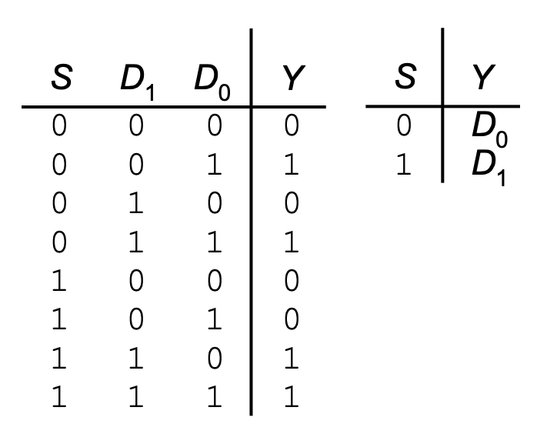
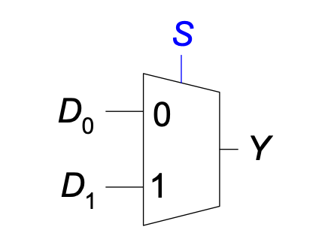
Multiplexer (Mux)
Selects between one of N inputs to connect to output
Example:
2:1 Mux

Slide 13
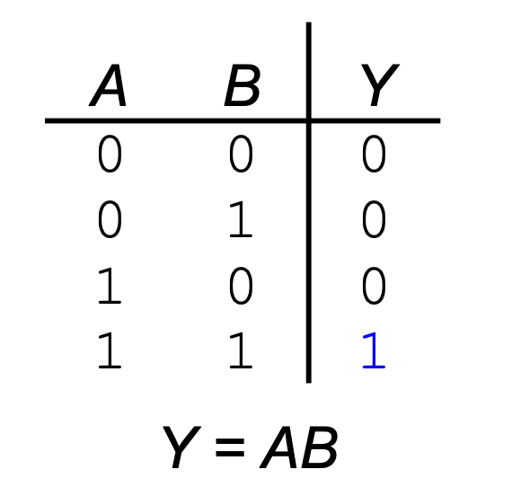
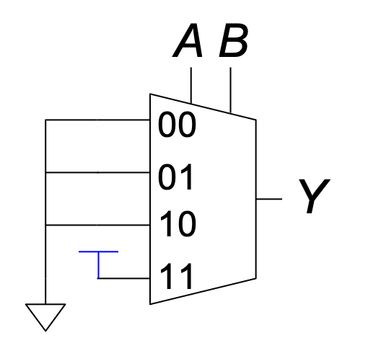
Logic Applications using Multiplexers
Using mux as a lookup table to replicate a logic gate of some kind:

Slide 14
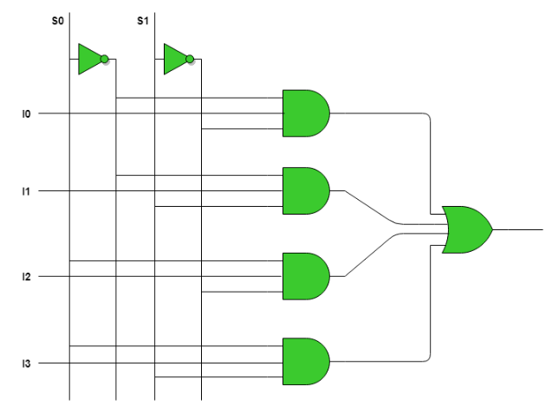
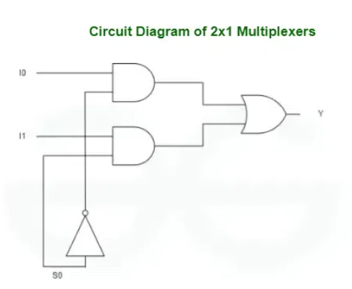
Multiplexer (Mux)
The “under the hood” logic for a multiplexer would look like this for a 4:1 and 2:1 MUX respectively:
Therefore, we want to reduce the size of the MUX when we can!

Slide 15
Logic Applications using Multiplexers
Reducing the size of the mux

Slide 16
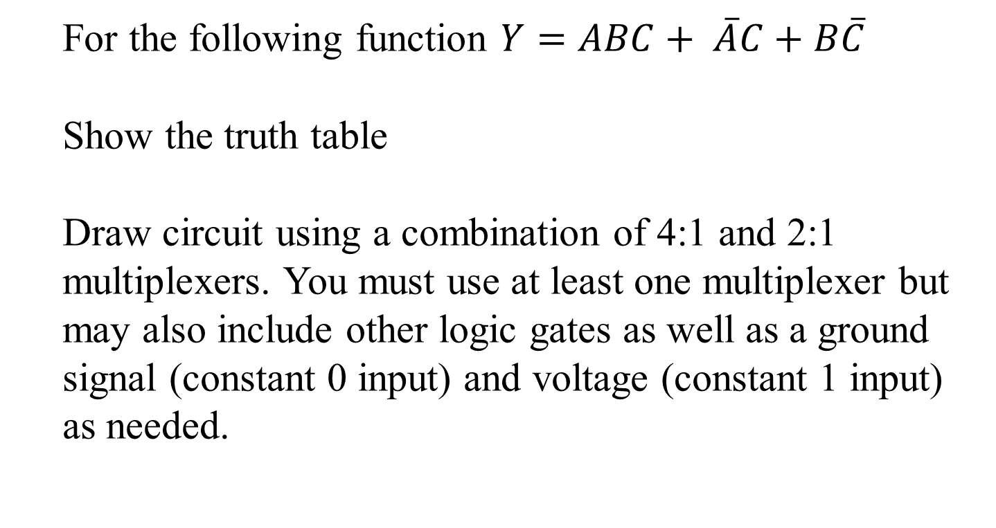
Logic using Multiplexers
For the following function $Y=ABC+ \overline{A}C+B\overline{C}$
Show the truth table
Draw circuit using a combination of 4:1 and 2:1 multiplexers. You must use at least one multiplexer but may also include other logic gates as well as a ground signal (constant 0 input) and voltage (constant 1 input) as needed.

Slide 17
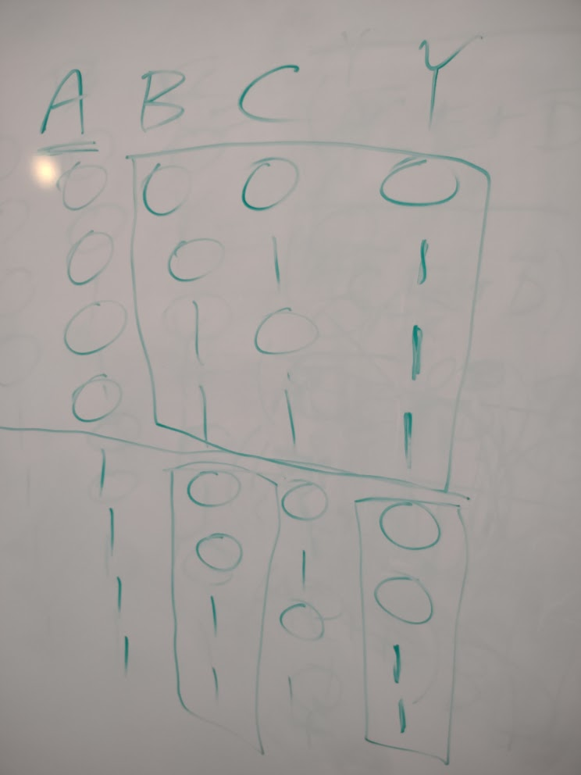
Logic using Multiplexers
$$Y=ABC+ \overline{A}C+B\overline{C}$$

Slide 18
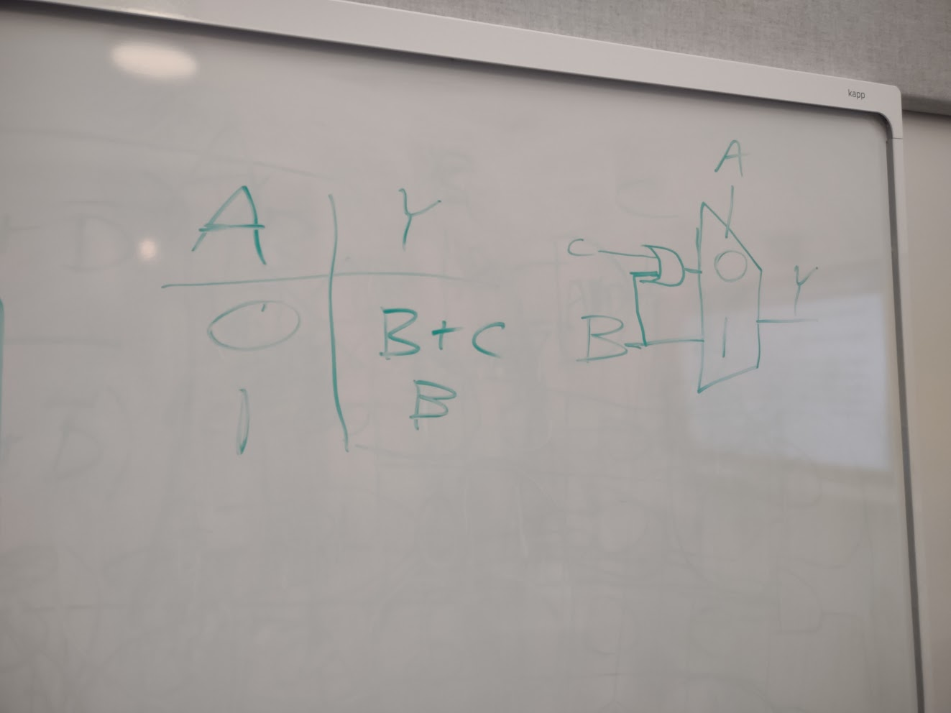
Logic using Multiplexers
$$Y=ABC+ \overline{A}C+B\overline{C}$$

Slide 19
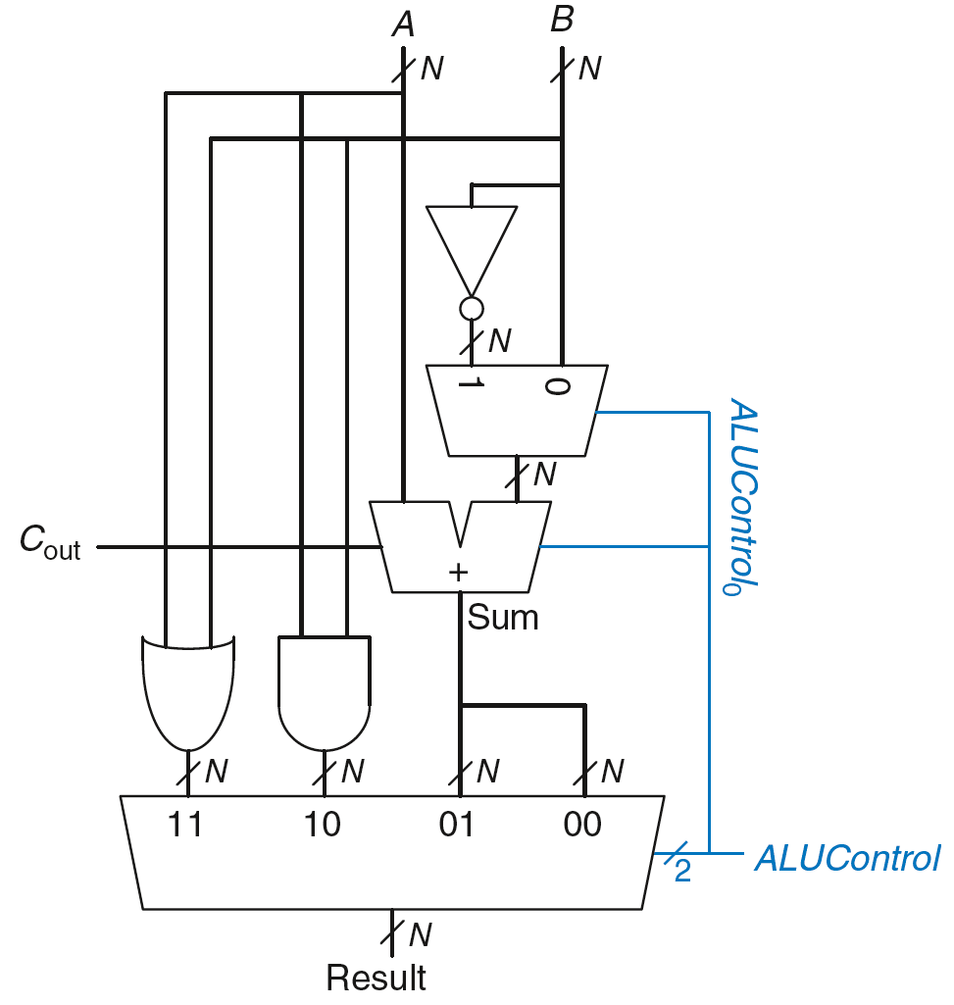
ALU: Arithmetic Logic Unit
ALUControl_{1:0} | Function
00 | Add
01 | Subtract
10 | AND
11 | OR
Example: Perform any of them

Slide 20
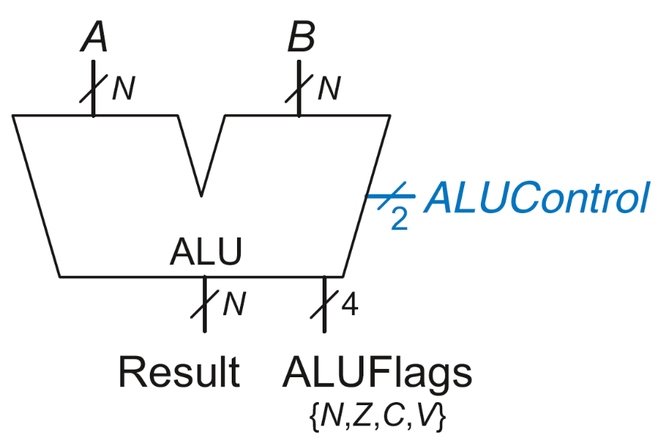
ALU with Status Flags
Flag | Description
N | Result is Negative
Z | Result is Zero
C | Adder produces Carry out
V | Adder oVerflowed

Slide 21
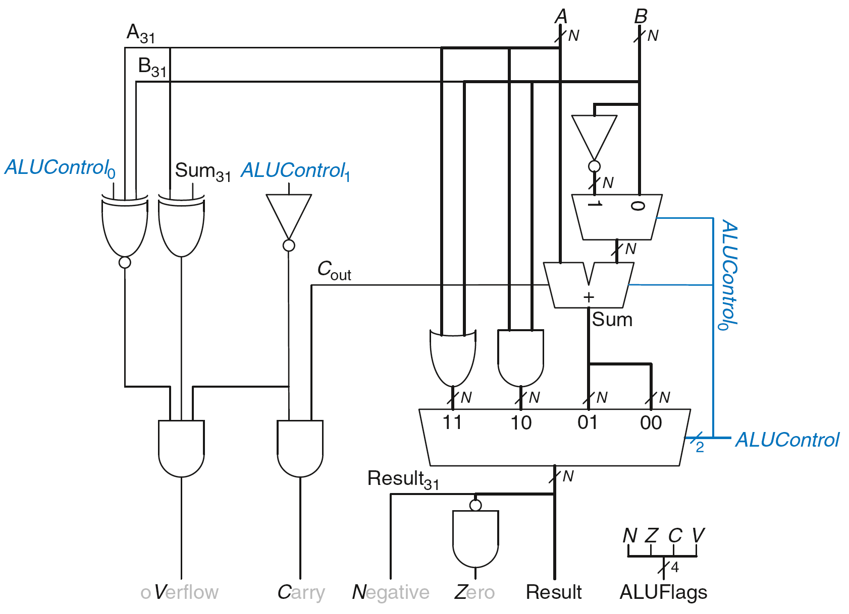
ALU with Status Flags

Slide 22
Today’s Tasks
Implement ripple-carry adder for two 8-bit numbers, test via simulation
Implement carry-lookahead adder for two 8-bit numbers broken up into two 4-bit blocks, test via switches and LED’s
Implement multiplexer (from a more traditional higher-level perspective), test via simulation
Implement ALU and test with switches and LED’s
I would generally encourage you to try using previously created components to aid the process when possible (i.e. the ripple-carry adder is just 8 interconnected copies of the full adder)

Slide 23
Some helpful course pages
https://hardcaml-mini-course-at-stevens.github.io/hardcaml-docs/designing-circuits/combinational_logic
https://hardcaml-mini-course-at-stevens.github.io/hardcaml-docs/designing-circuits/mux4
https://hardcaml-mini-course-at-stevens.github.io/hardcaml-docs/designing-circuits/alu

